Slide 1
70
Discrete Mathematics
Introduction to Relations

Slide 2






















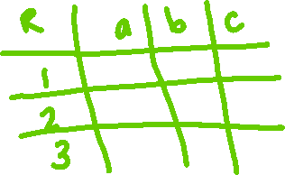














Slide 3


















Slide 4







Slide 5







Slide 6
Up Next…
Properties of Relations

